Slide 1
Introduction to Node.js

Slide 2
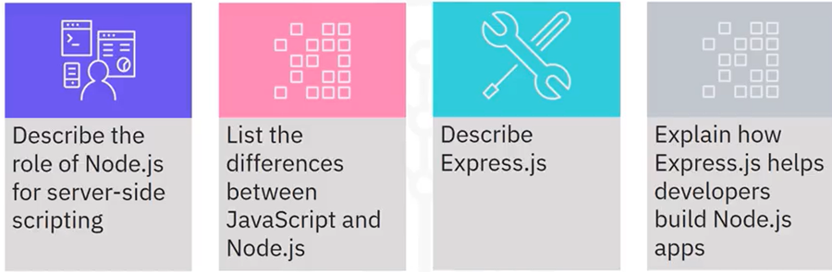
What you will learn

Slide 3

Node.js definition
• Node.js is an open-source language that runs on V8
• V8 is an open-source engine developed by Google for the Google Chrome browser

Slide 4

Node.js functionality
• Developers frequently use JavaScript to code client-side capabilities. Node.js is the server
component in the same language
• Node.js is event-driven and uses asynchronous, non-blocking I/O

Slide 5
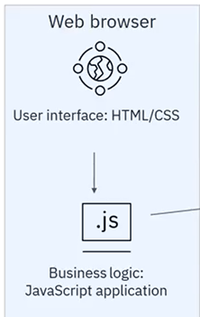
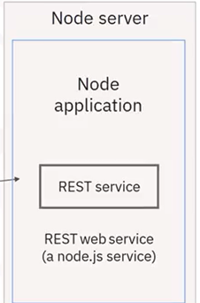
JavaScript with Node.js
JSON/HTTP

Slide 6

Node.js usage
• Developers can now use Node.js in the
same components of the architecture
where they use Java, Perl, C++,
Python, and Ruby
• Node.js is used in production by
companies like Uber, Yahoo!, Linkedln,
GoDaddy, eBay, and PayPal

Slide 7
Express.js
• Configurable framework for building applications on
Node.js
• Abstracts lower-level APIs in Node.js by using HTTP
utility methods and middleware

Slide 8
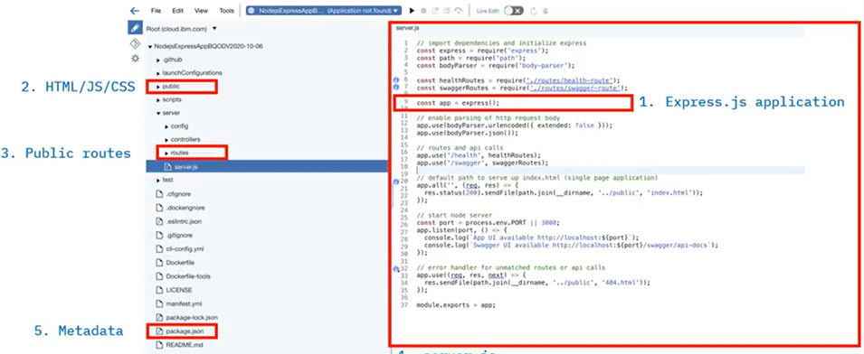
Node and Express in the IDE

Slide 9
Recap
In this video, you learned that:
• Node.js is the server-side component of JavaScript
• Using Node.js can improve application performance
• Express.js is a framework that helps you build Node.js
applications

